Slide 1

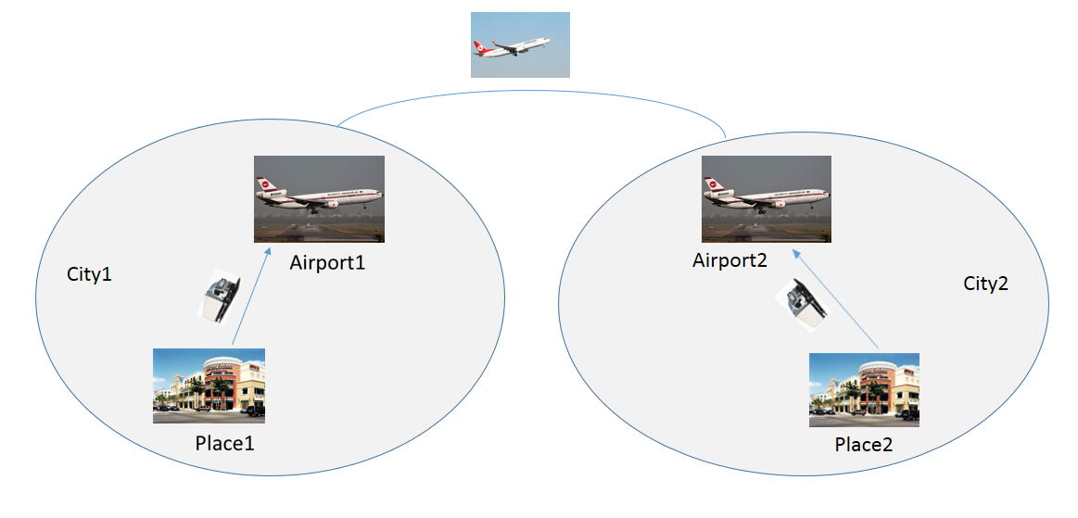
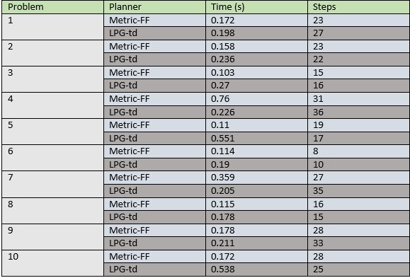
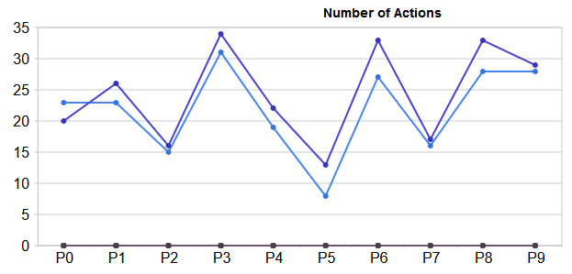
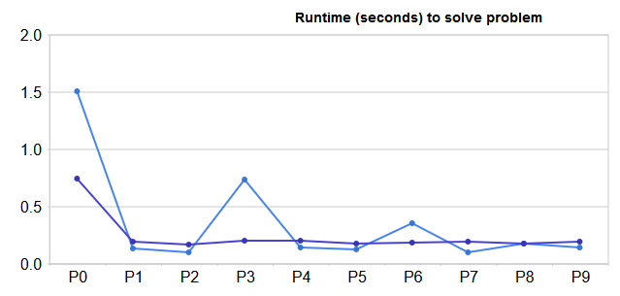

A Comparative Analysis of PDDL-Based Planning Using Multiple AI Planners
Rifat Sabbir Mansur (0905036)
Md. Arif Hasnat (0905040), Md. Rafatul Amin (0905043)
Background
Methodology
Planning Domain Description Language, PDDL, released by Drew McDermott in 1998 has since become a community standard for the representation and exchange of planning domain models. [1]
PDDL contains STRIPS, ADL and much more. Most planners, however, do not support full PDDL. The majority support only the STRIPS subset, or some small extension of it.
Metric-FF is a domain independent planning system developed by Joerg Hoffmann. The system is an extension of the FF planner to (ADL combined with) numerical state variables, more precisely to PDDL 2.1 level 2. [2]
LPG-td (2004-present), an enhanced version of LPG (a fast planner based on local search techniques and planning graphs), also work with the language features of PDDL2.2 (with Alfonso Gerevini, Ivan Serina and Paolo Toninelli). [3]
Domain Specification:
Packages are moved from their initial location to destination (goal location).
There are two types of locations in every city:
  Place Locations
  Airports
There are two types of agents:
  Truck: used to move packages from a place to airport within a city.
  Airplane: used to move packages from one airport to another between two cities.
Planner’s goal is to find minimum steps to move packages.
Model testing with AI planners:
10 different problems based on the domain is solved with different planners by itSIMPLE4.0-beta4 software.
Only the planners Metric-FF and LPG-td produced effective results.
Work plan
Schematic Diagram
Several planners, effectively, Metric-FF and LPG-td, have been used to comparatively analyze 10 different problems based on a well known domain named “Logistics” introduced in the IPC2000
Study the solutions in terms of number of steps required and runtime of the planners to solve the problems.
Application
itSIMPLE4.0-beta4, a Knowledge Engineering tool, has been used for domain specification, modeling, analysis, model testing with AI planners and maintenance. [4]
The tool uses various AI planners such as:
Metric-FF, LPG-td 1.0, Blackbox 4.2, Marvin IPC-4 etc.
Among the planners, only few produce effective results for a particular domain.
Results and Evaluation
Outcome
Conclusion
When packages are moved between cities, more steps are required than when packages are moved within a city.
Example:
  In problem 1: 2 packages are moved within a city and 2 packages are moved between two different cities. Total of 23 steps are required according to Metric-FF planner.
  However, in problem 5: 3 packages are moved within a city and one package is moved between two cities. Total of 19 steps are required.
  Here, fewer packages are moved between cities resulting fewer steps.
Comparative analysis between different types of planners on a particular problem based on their efficiency in finding minimum steps and runtime.
Further analysis to be done about the domain to choose the best possible planners to solve.
Reference
[1] McDermott, Drew; Ghallab, Malik; Howe, Adele; Knoblock, Craig; Ram, Ashwin; Veloso, Manuela; Weld, Daniel; Wilkins, David (1998)."PDDL---The Planning Domain Definition Language“
[2] https://fai.cs.uni-saarland.de/hoffmann/metric-ff.html
[3] Alfonso Gerevini , Alessandro Saetti , Ivan Serina , Paolo Toninelli. “LPG-TD: a fully automated planner for PDDL2.2 domains (2004)”
[4] https://code.google.com/p/itsimple/
Department of Computer Science and Engineering (CSE), BUET

